Slide 1
PowerPoint Template (Dark)
2025 Meeting of the Minds (MOTM25)

Slide 2
Instructions

Slide 3
Adjust Your Logo
View > Master > Slide Master
Select Upper Most Slide (The overall master slide)
Replace Logo in lower right
  Must be Light Color w/ Transparent Background

Slide 4
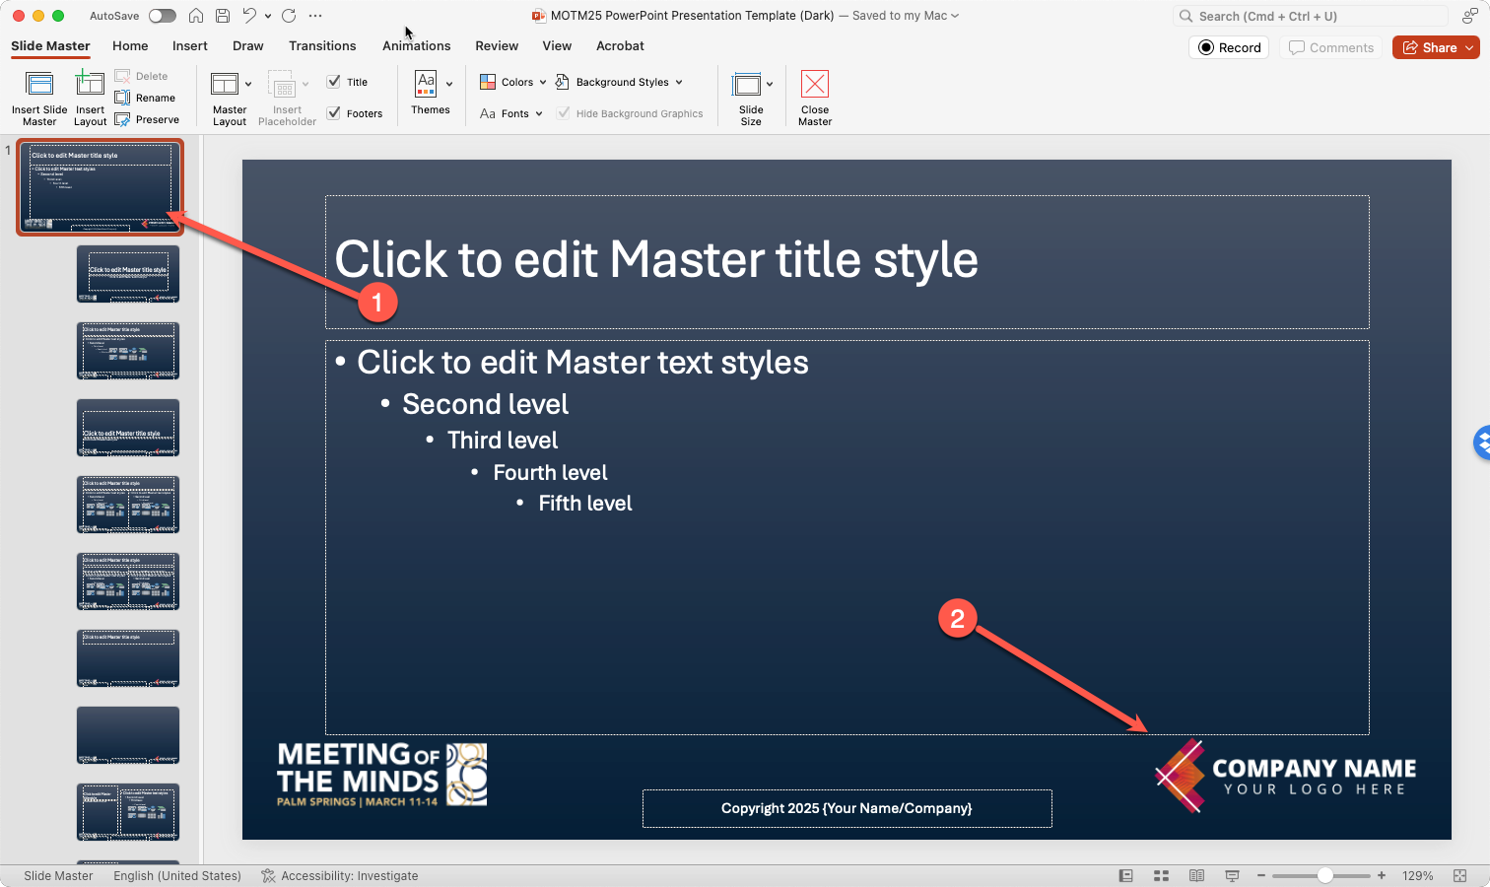

Slide 5
Adjust Footer
Menu: Insert > Header and Footer
Adjust as necessary

Slide 6
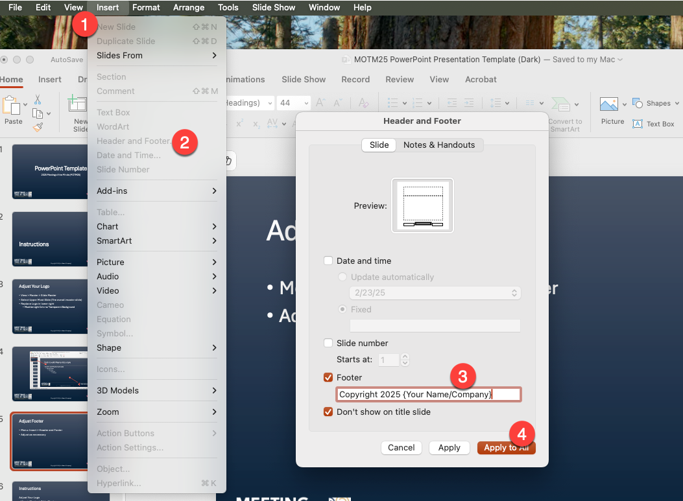

Slide 7
Delete / Update Template Slides
Delete and/or Update These very template slides

Slide 8
